Slide 1

Airline Reservation System

Slide 2

Our Team
Group member :
_ Huỳnh trần thế hùng
_ Nguyễn văn nhân
_ Nguyễn ngọc sơn tùng
_ Hoàng hải long
Tutorial Lecturer
_ Mr. Hoàng đức quang

Slide 3


1.Customer

Slide 4
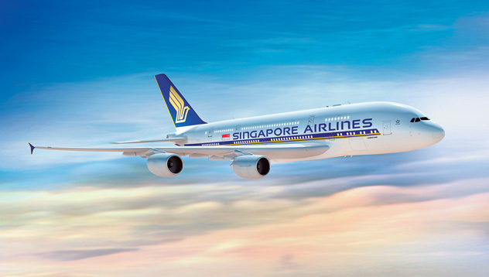
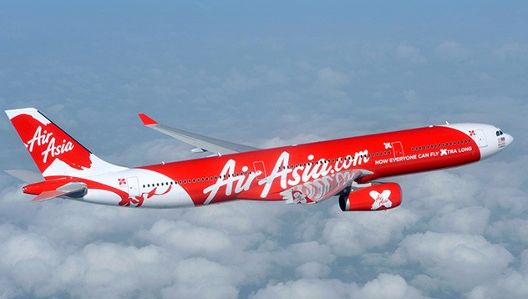
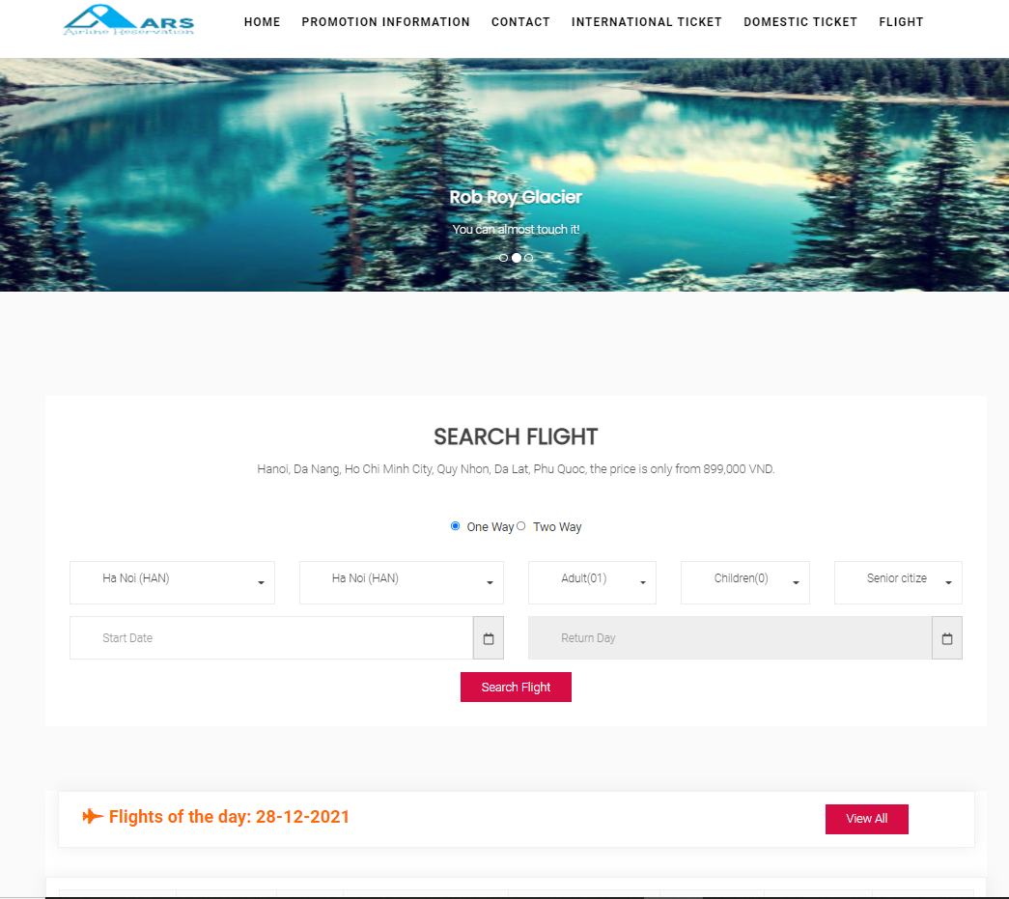
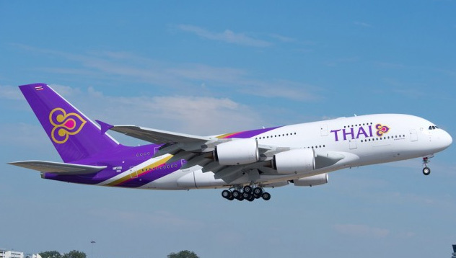
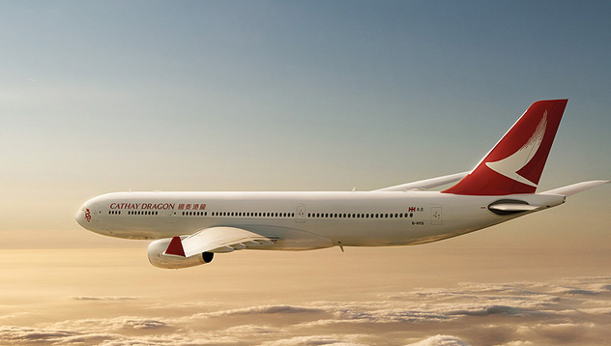
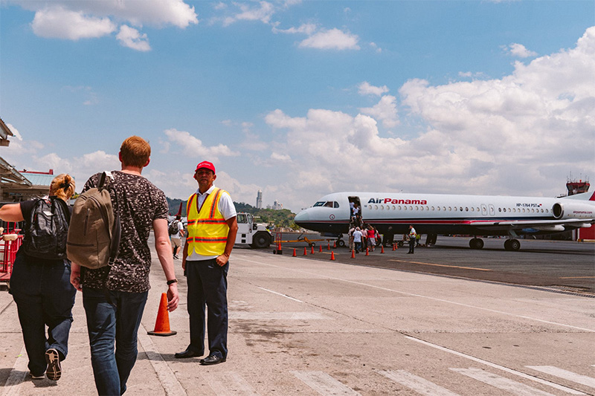
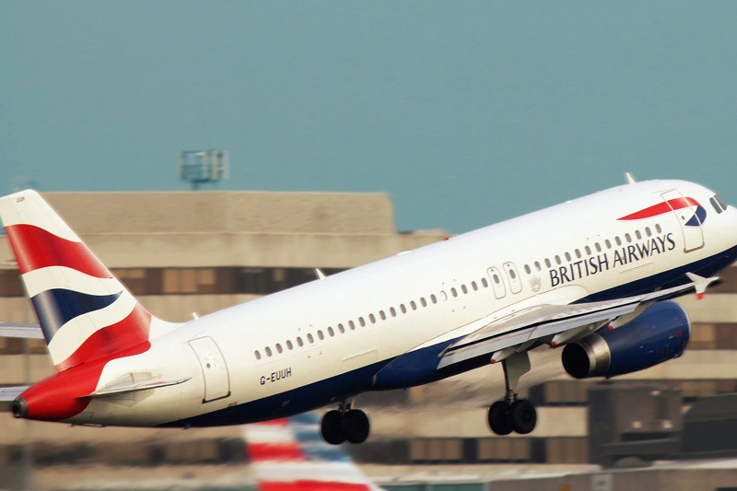
HomePage
1
2
3
4
5
6

Slide 5
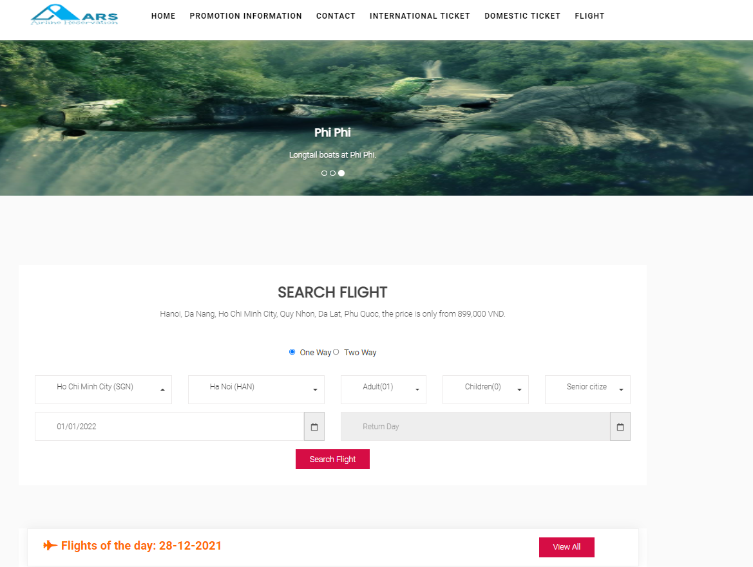
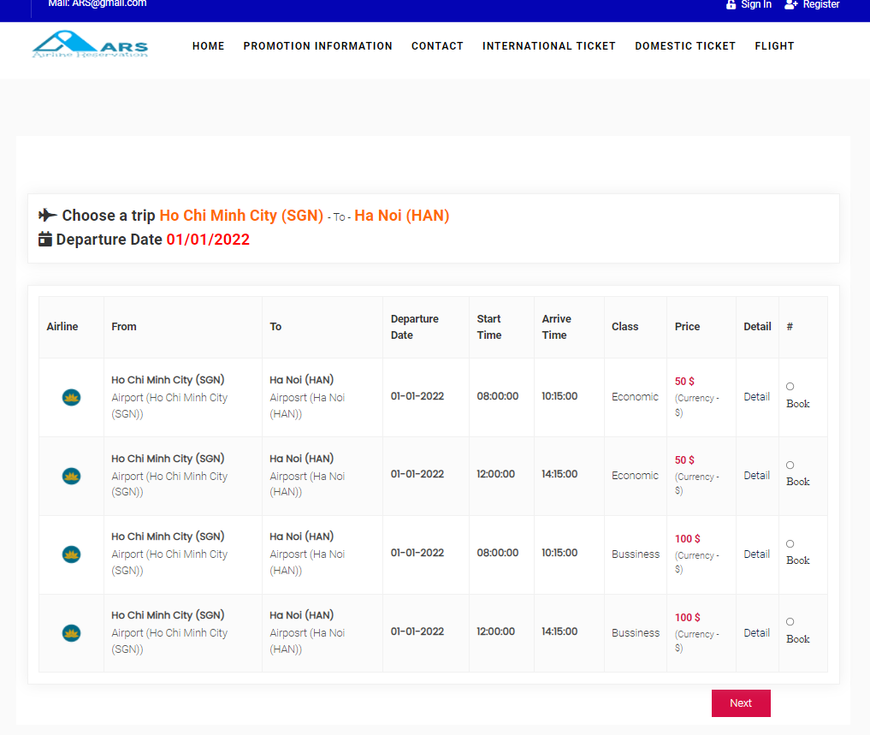
Search Flight Ticket

Slide 6
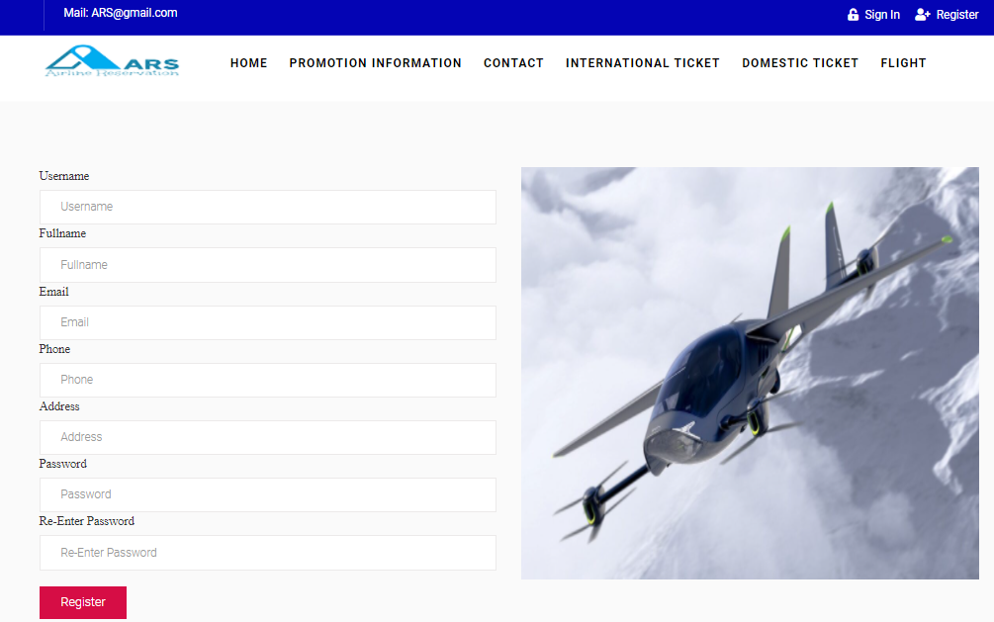
Register Account to Sign-In

Slide 7
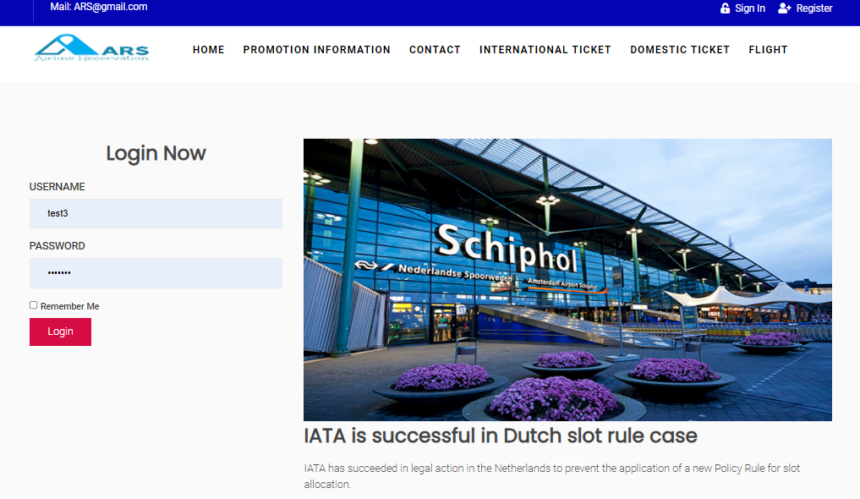
Sign-In To Pay Order Booking

Slide 8
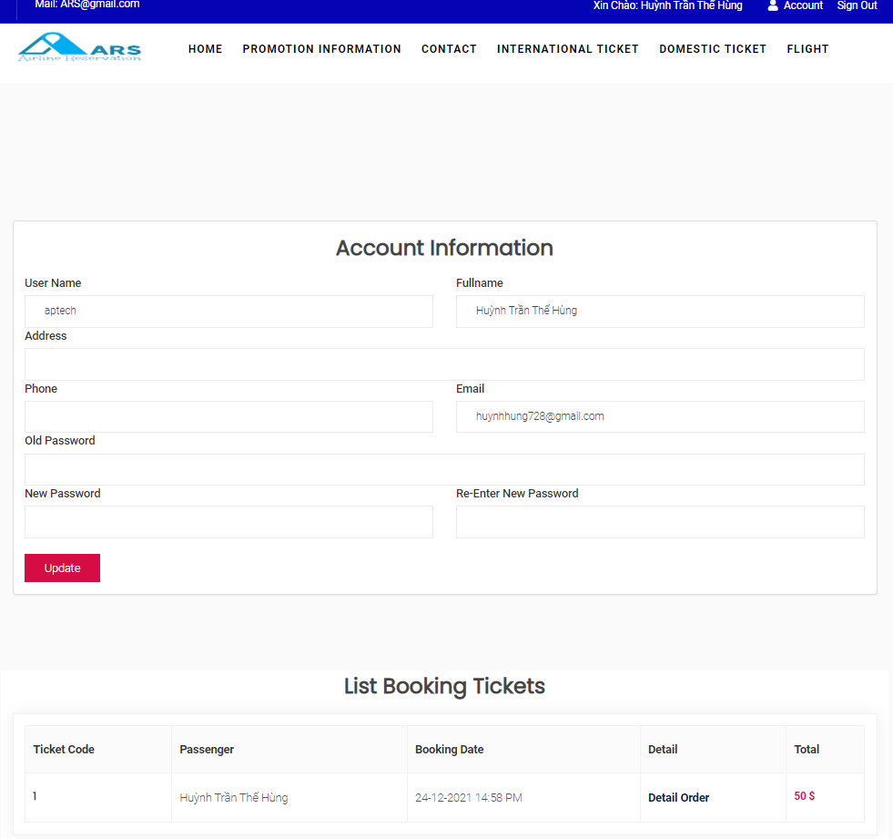
Edit Account

Slide 9
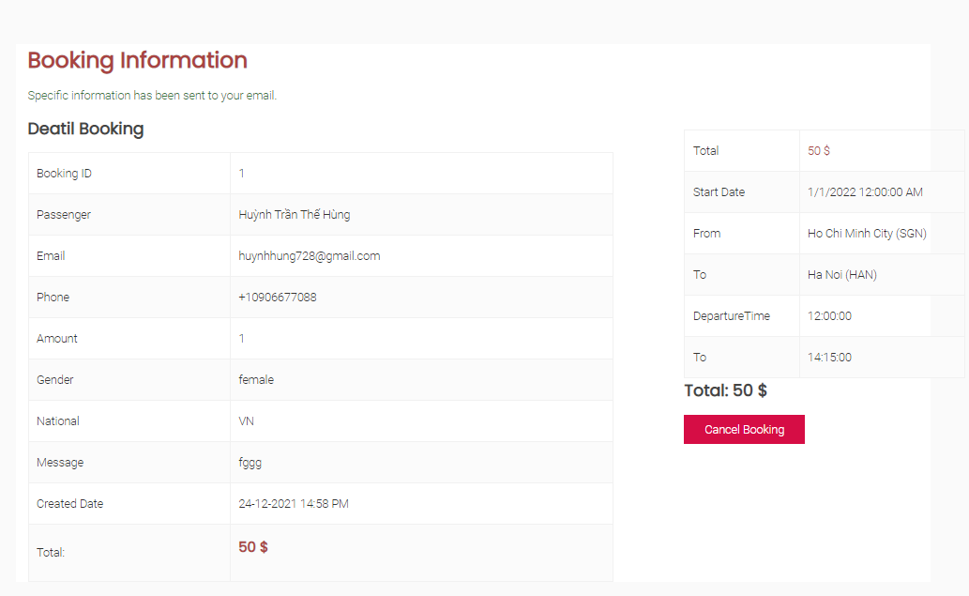
Order Detail

Slide 10
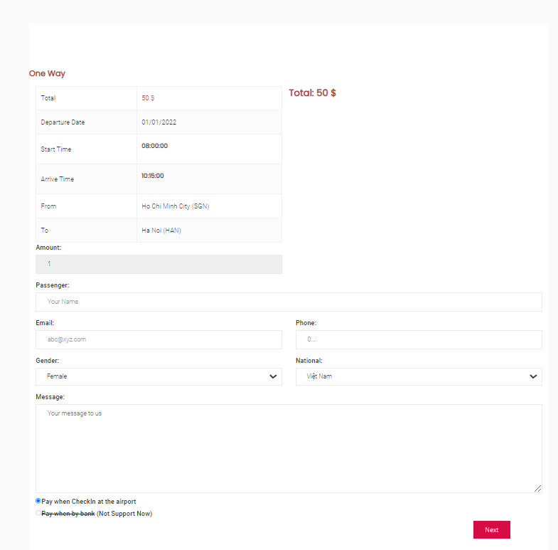
Payment

Slide 11
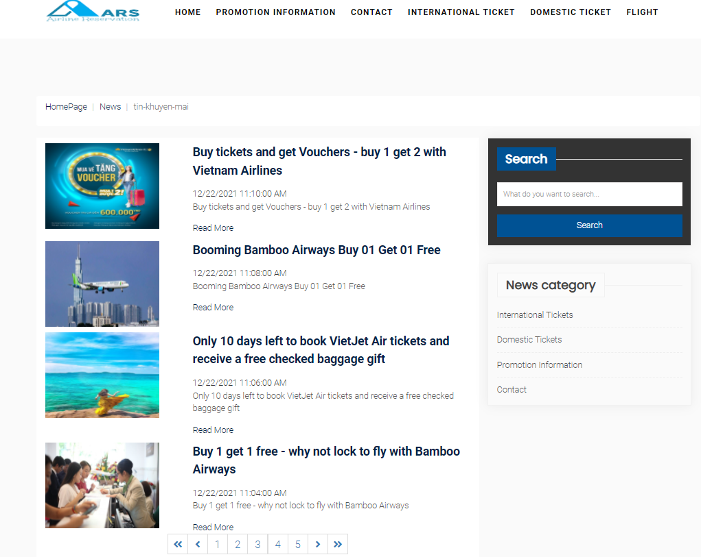
News Promotion

Slide 12
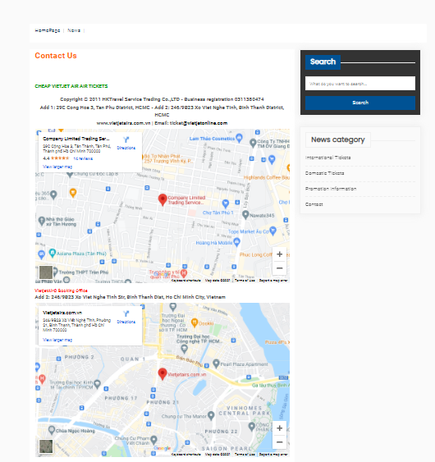
Contact Agent

Slide 13
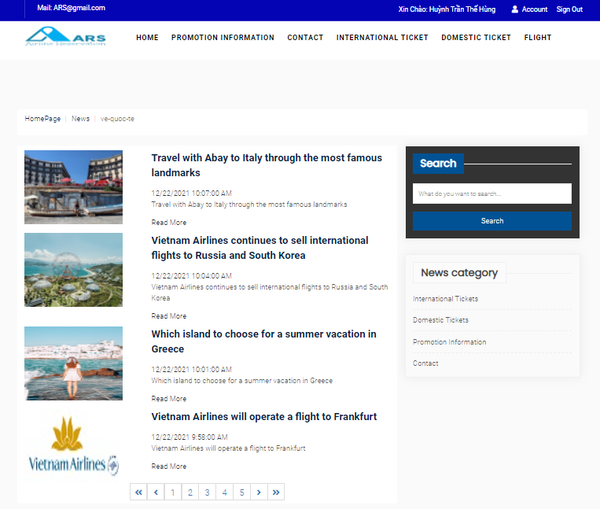
News International Flights

Slide 14
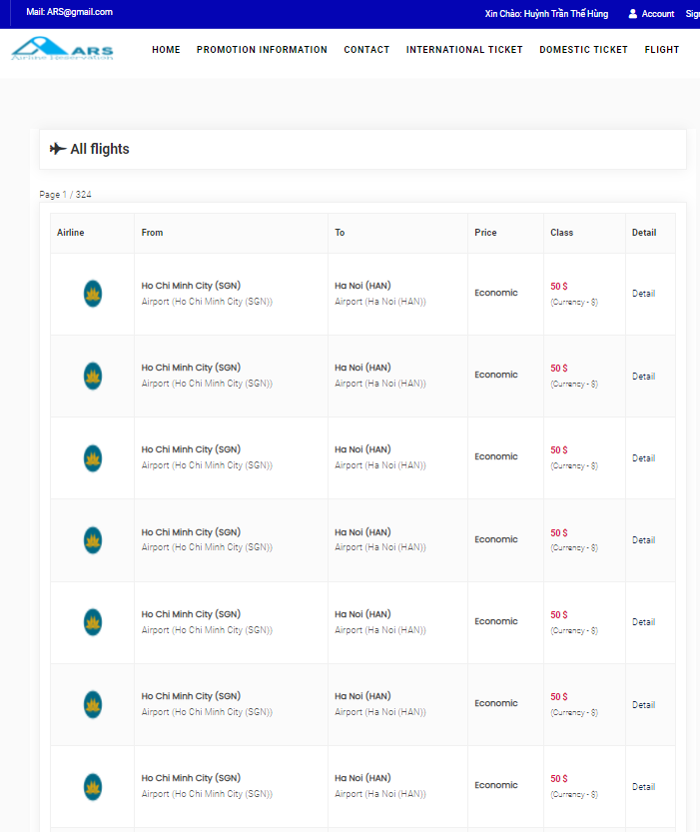
View Flights

Slide 15
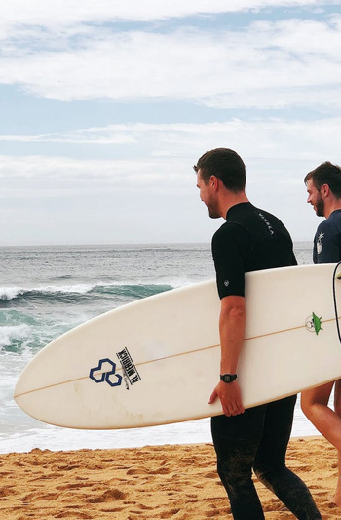
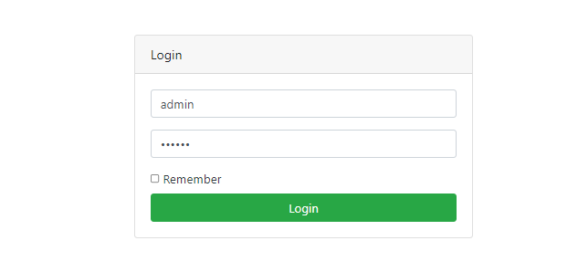
2.Business
Three type of account:
ADMIN (Manage All)
SALESMAN(Limited)
CUSTOMER(Limited)

Slide 16
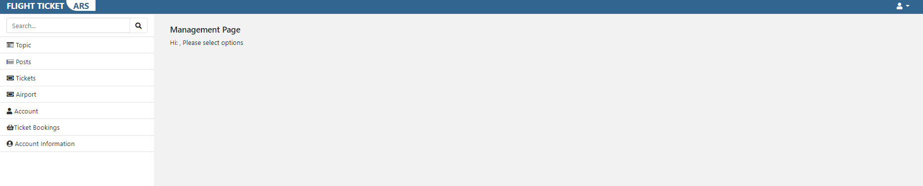
Hompage Admin

Slide 17
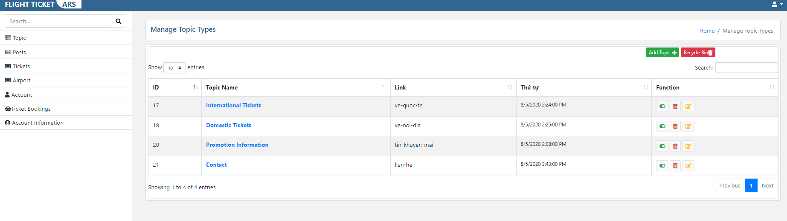
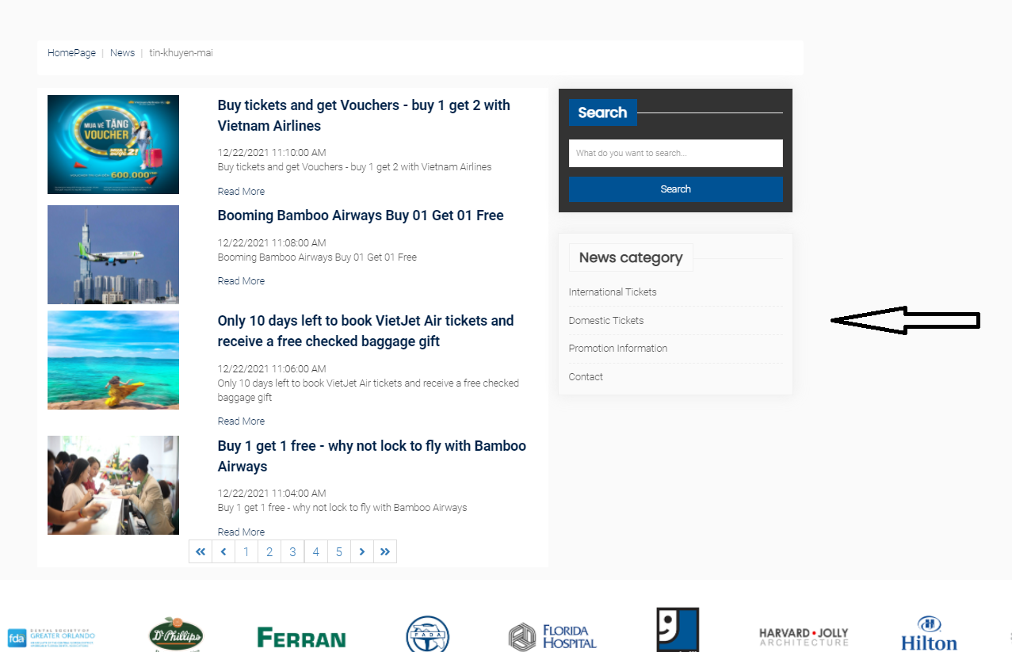
Manage Topic

Slide 18
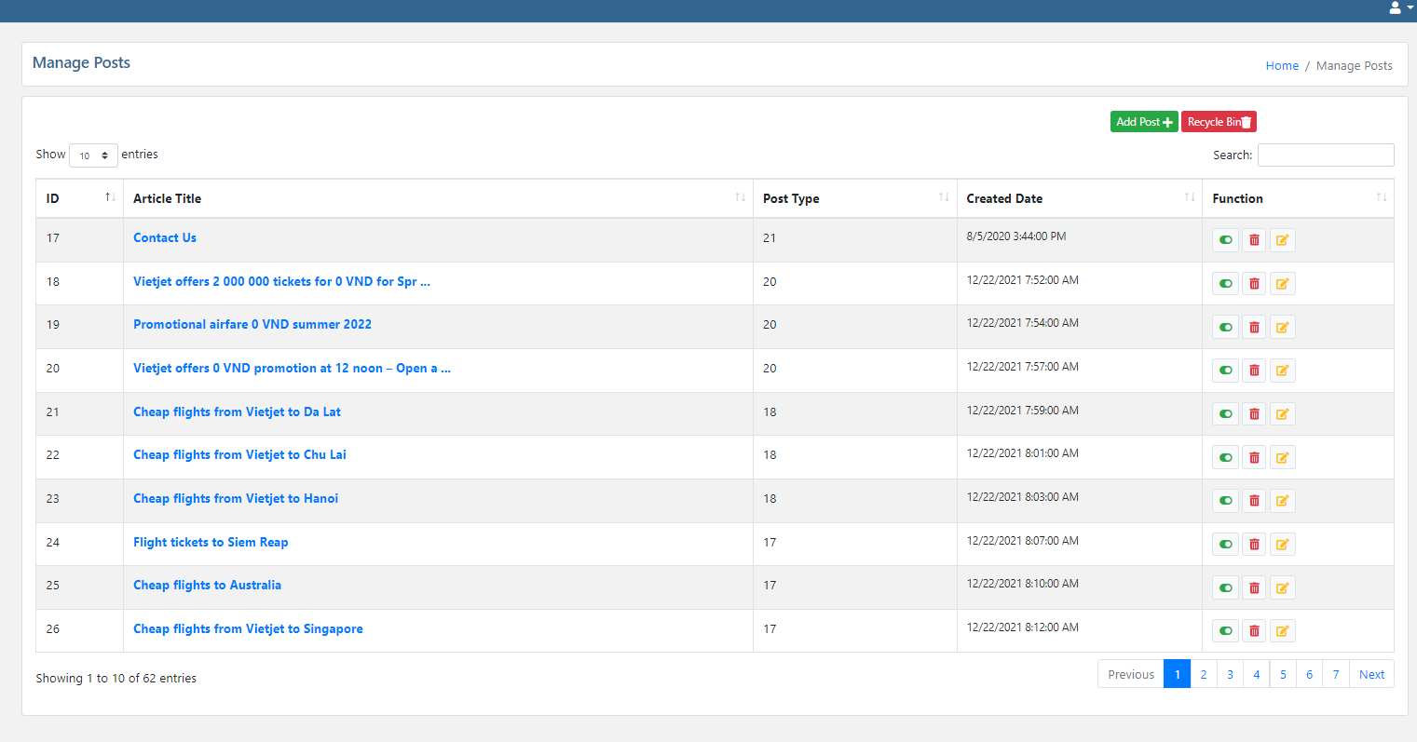
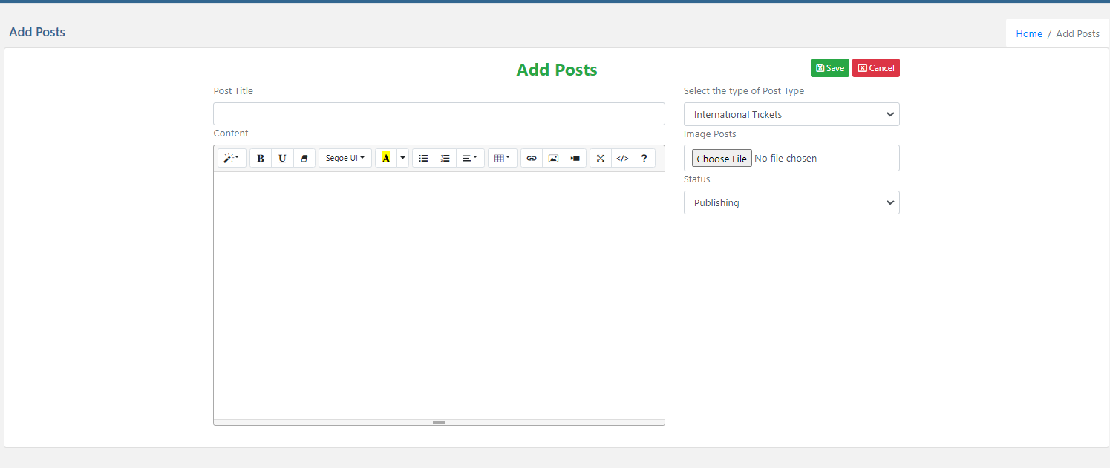
Manage Posts

Slide 19
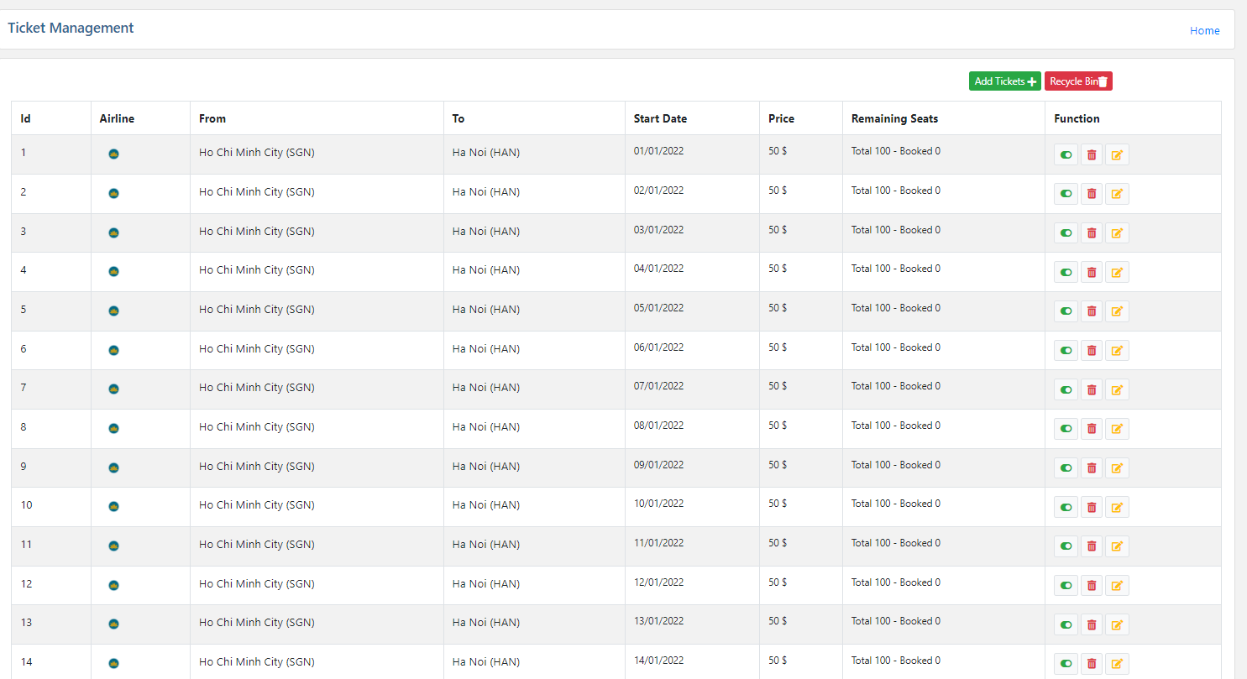
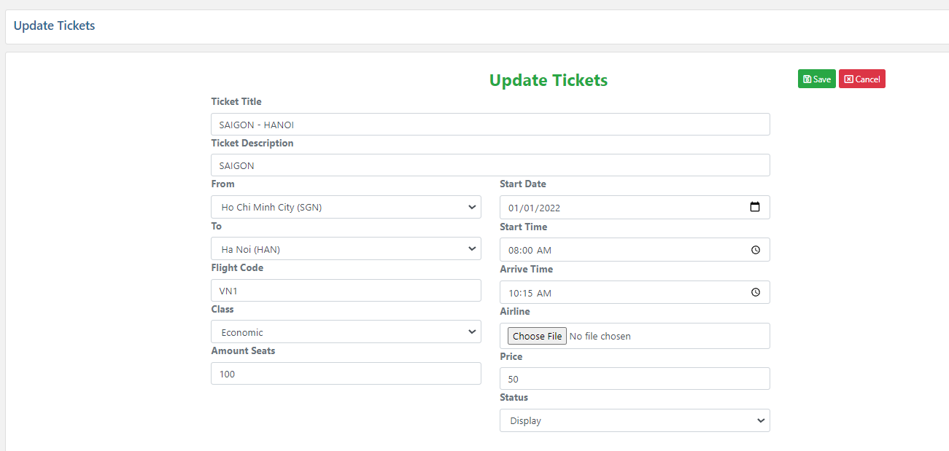
Manage Tickets

Slide 20
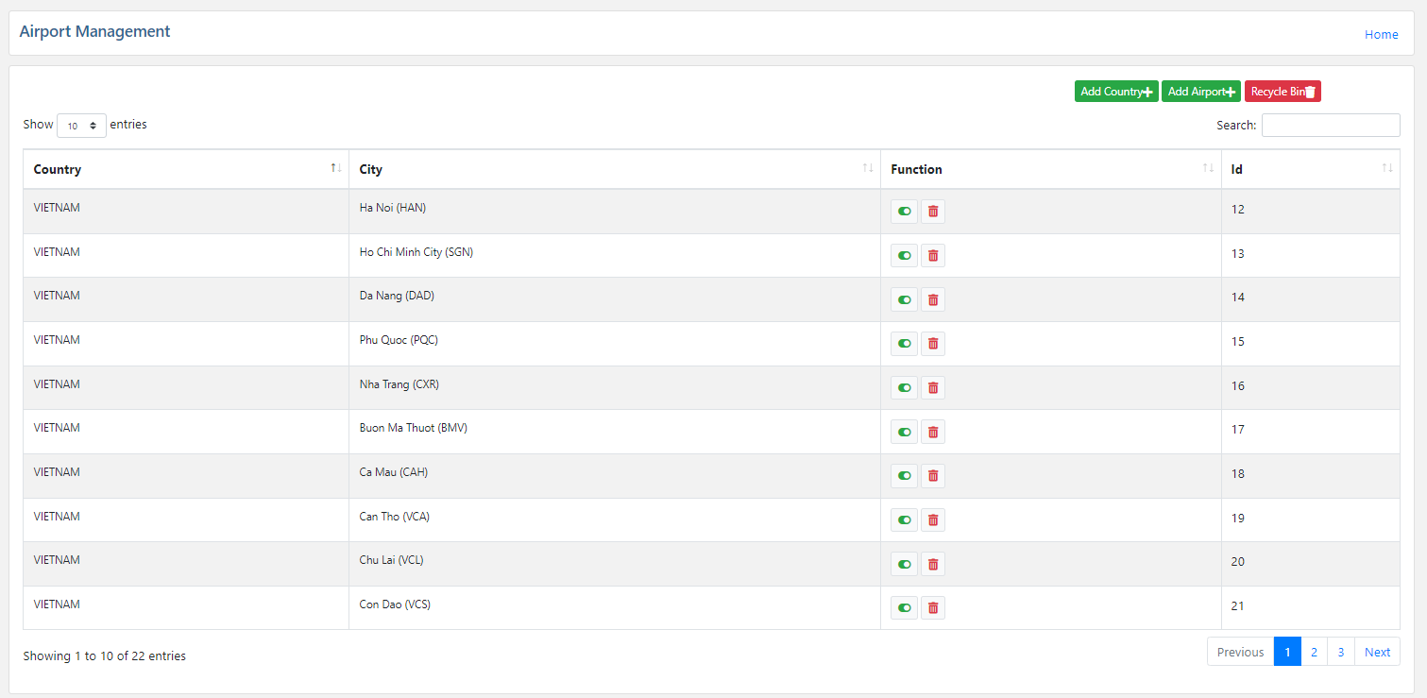
Manage Airport

Slide 21
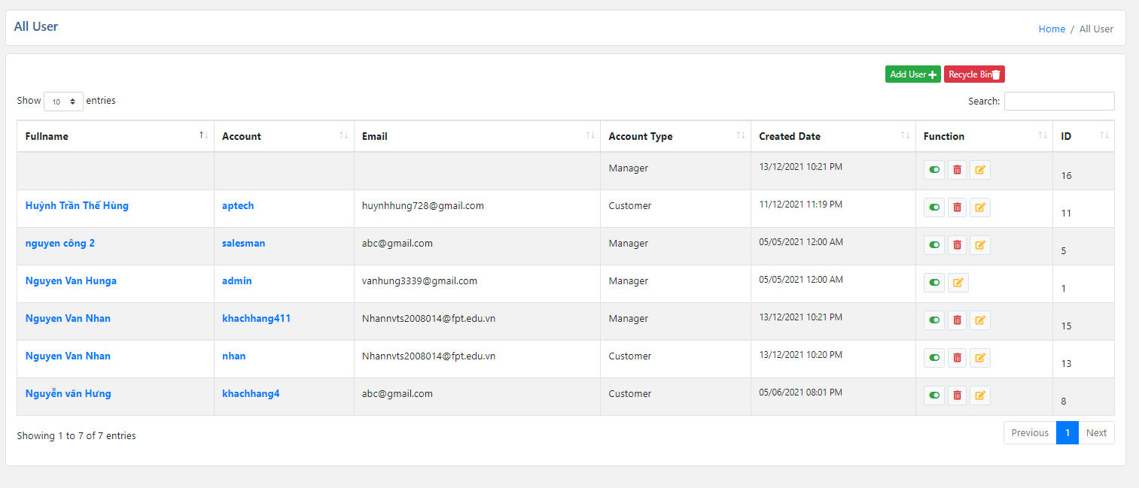
Manage Account

Slide 22
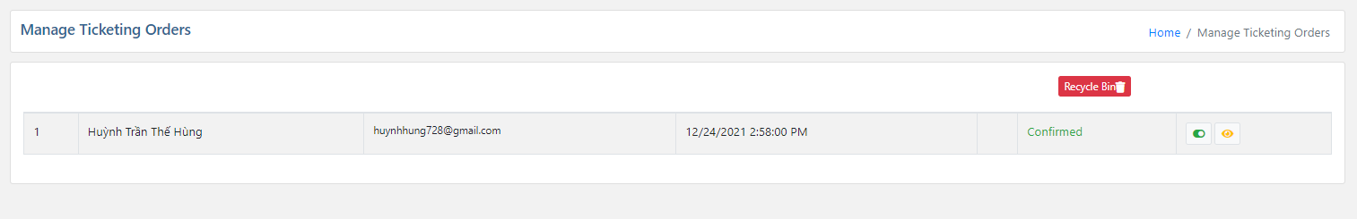
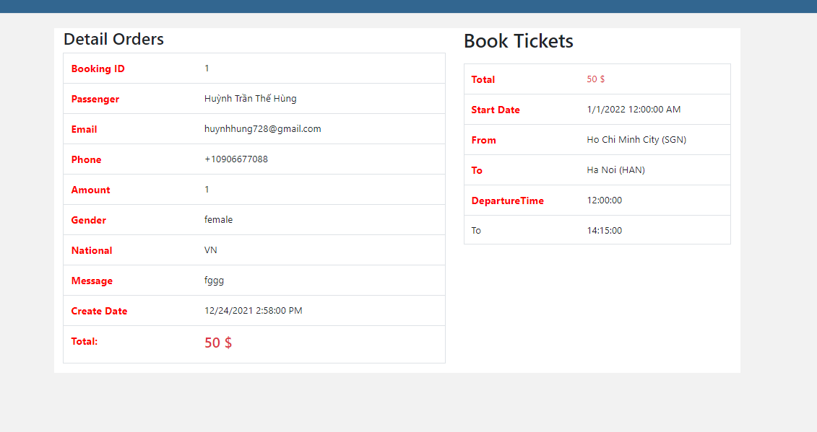
Manage Ticket Booking

Slide 23
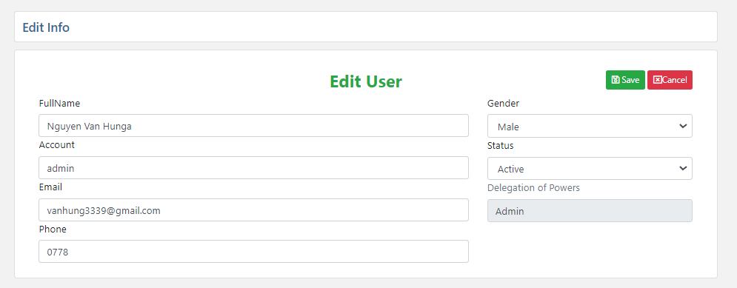
Manage Account Information

Slide 24

3.Task Sheet
Project Ref. No.: Airline Reservation System |  | Project Name | Activity Plan Prepared By | Date of Preparation of Activity Plan:
Sr./No. | Task |  |  | Actual Start Date | Actual Days | Team member name | Status
1 | Admin page | Airline Reservation System | All team | 11-Dec-21 | 28 | Hùng | Completed
2 | Home page |  |  | 11- Dec -21 | 28 | Hùng | Completed
3 | Search Flight |  |  | 12- Dec -21 | 29 | Nhân | Completed
4 | Promotion page |  |  | 12- Dec -21 | 29 | Nhân | Completed
5 | Login page |  |  | 12- Dec -21 | 30 | Tùng | Completed
6 | Register page |  |  | 11- Dec -21 | 30 | Tùng | Completed
7 | Checkout page |  |  | 12- Dec -21 | 28 | Hùng | Completed
8 | News page |  |  | 12- Dec -21 | 30 | Long | Completed
9 | About us page |  |  | 13- Dec -21 | 3 | Long | Completed
10 | Contact us page |  |  | 13- Dec -21 | 4 | Nhân | Completed
11 | Change Topic Page |  |  | 14-Dec-21 | 3 | Nhân | Completed
12 | Tickets Page |  |  | 15-Dec | 3 | Nhân | Completed

Slide 25

Large Image slide

Slide 26


Thank You For Watching
airline.com

